Slide 2





Experiments with sensorimotor games in dynamic human/machine interaction
Electrical & Computer Engineering
University of Washington
Seattle, WA USA
AMP Lab
http://depts.washington.edu/amplify
Benjamin Chasnov
Momona Yamagami
Behnoosh Parsa
Lillian Ratliff
Sam Burden
Notes:
Hi, I’m Ben. I’m a graduate student at the University of Washington in Seattle.
Today I give an overview of the work that we’re doing at the University of Washington regarding sensorimotor games in human-machine dynamic scenarios.
The first half of my talk will be focused on building up the theoretical framework of decision-making and control that we’ll be using in this work.
And the second half will go through some of our preliminary experimental results of humans learning in these systems.

Slide 3
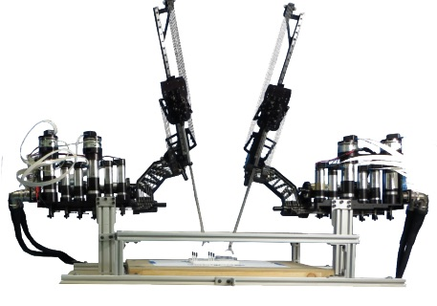
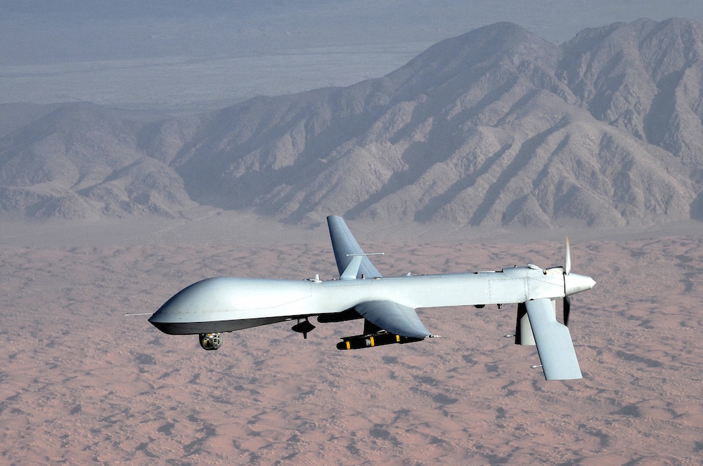
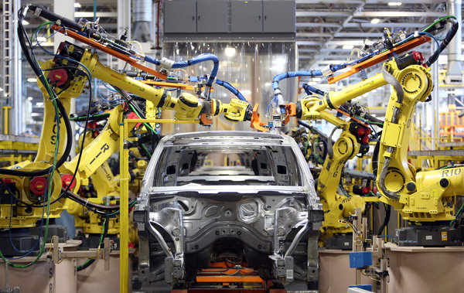
Our physical world is dynamic
Notes:
Our physical world is dynamic.
What I mean by this is that we have amazing abilities to predict the outcome of physical systems through differential equations.
—————————
Our physical world is dynamic.
Some of the best predictive models of our physical world can be described using differential equations.
The state can represent the continuous position, velocity and orientation of a drone.
The state can also be a discrete state, such as the state of a automobile factory.
Autonomous

Slide 4
Our physical world is dynamic
The state of the world, x, follows a set of governing differential equations.
Dynamic environment
Notes:
The function f holds all the structure of the dynamic system, with state x and and actions u.
Now x here represents the state of the system.
------------------
The control can be used to stabilize an otherwise unstable system, or to drive the state to some desired reference

Slide 5
Our physical world is dynamic
Notes:
In these examples, the state can represent different things.
On the left we have the end effector of a surgical robot. Its state can be the force being applied by the end effector on the tissue.
The state of the drone in the center can be the gps position, the altitude, velocity, the attitude.
On the right, we have autonomous industrial robots building a car.
A common feature of each of these systems is that not only do they all have a degree of autonomy, this autonomy is also mediated by humans.

Slide 6
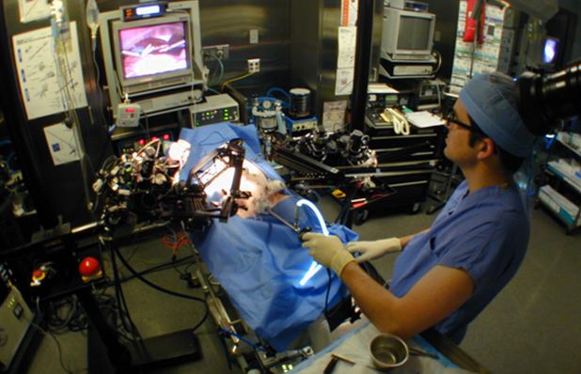
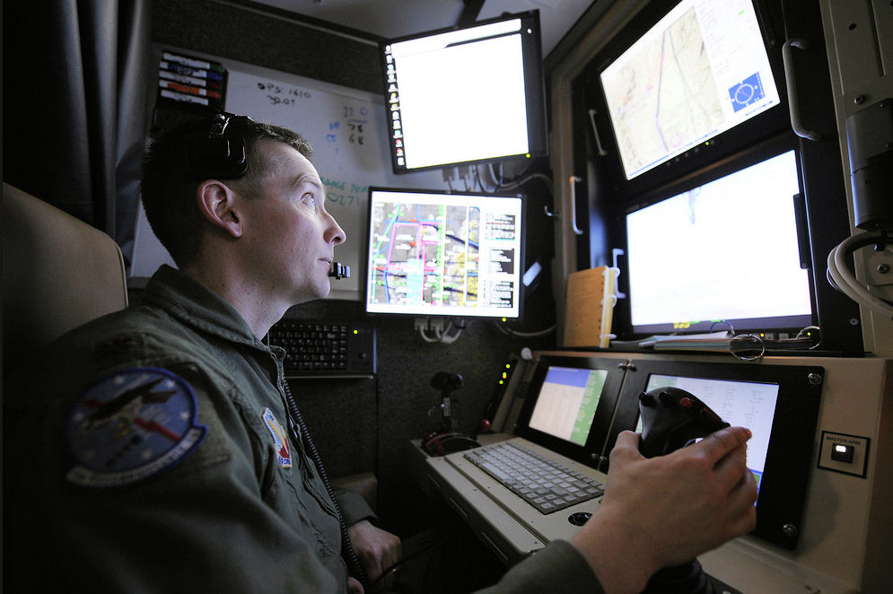
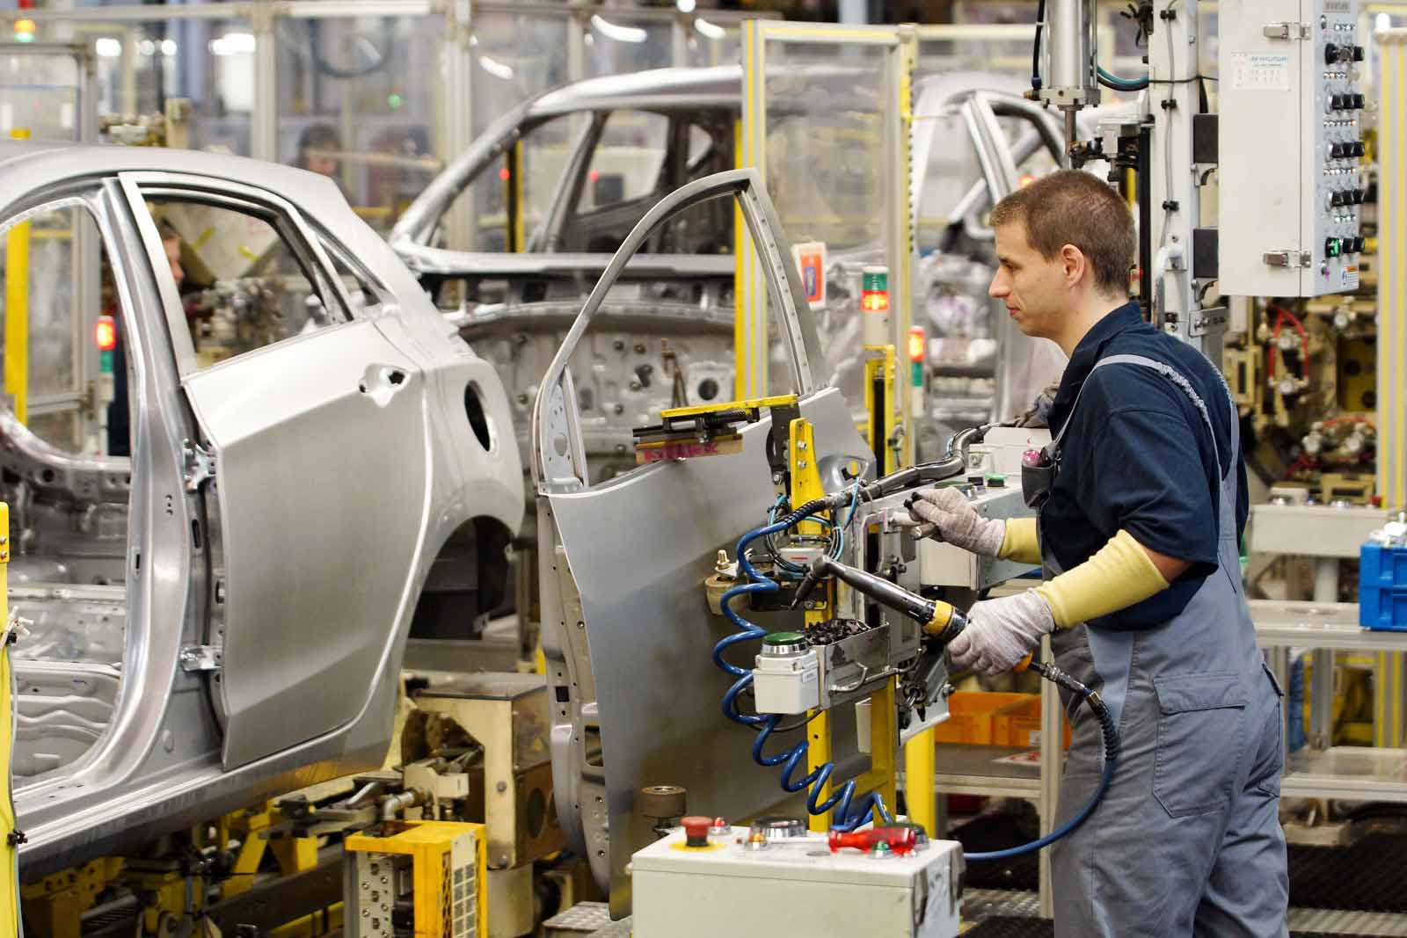
Machine control + Human teleoperation
Notes:
Behind each of these systems there are often human operators making decisions about how to control the system.
A surgeon is in close feedback with a surgical robot to guide incisions
A pilot commands and controls the drone.
Factory workers cooperate with industrial robots.

Slide 7
Team control of autonomous systems
Machine actions:
Human actions:
Notes:
We use these three examples to motivate the framework that we’ll be adopting in this work, describing this division of labor more formally leveraging control-theoretic and game-theoretic models.
Here, the actions of the machine denoted in this presentation as u subscript M.
And the actions by the human is denoted by u subscript H
———————-
1. We acknowledge that certain actions are best done by the machine, Machines are best as making quick reactions and tracking trajectories, and stabilizing systems
Humans are best at making higher level and guided expert decisions
ADD POINTS:

Slide 8
Team control of autonomous systems
The joint action u drives the state x in the dynamical system. Where are the feedback loops?
Dynamic environment
Notes:
u is the joint control of the human and machine.
If anything from the study of control theory and cybernetics has taught us, its that feedback loops are at the core of what it means to control systems.
Feedback loops are everywhere.
Where are the feedback loops in this model?
———————-
If the system is controllable, then there exists a sequence of us that can drive x to anywhere in the state space.
if the dynamics of the original system is unstable, feedback loops can help stabilize the system, making figher jets that are inherently unstable into stable machines.
Regulate the system

Slide 9
Feedback loops: autonomous controller
The machine controls the system by reacting to state x, and choosing control u_{M.}
Dynamic environment
Notes:
The first feedback loop is the one involving the machine. The machine observes some state x, and makes a decision to apply an action uM
This can be in the of anything from a simple PID controller to a full blown AI system.
The second feedback loop
———————-
The machine also has an idea of how to control the system. Maybe it has a specific gait trajectory it needs to follow to stabilize itself.
Our question now is the following: how do agents decide on a controller? What u’s do the agents — human or machine — choose and how does that relate to their own goal?

Slide 10
Feedback loops: human operator
Human teleoperates a dynamical system by providing control input u_{H} in feedback with observing x.
Dynamic environment
Notes:
The second feedback loop is with the human operator. The human also observes some state x, and applies input u.
Now that we have developed the model of the coupled human-machine system, we are well positioned to pose the following question:
How do agents make decisions?

Slide 11
A model of decision-making
A “rational” agent minimizes a cost c_{H}(u) subject to dynamical constraints.
Dynamic environment
Notes:
A common model of decision-making, that has been used in economic theory and control theory, is that of utility maximizing or cost minimizing agents. This is the learning model we will adopt in this presentation.
We assume each agent has a cost that they’re trying to minimize. For example, the human here is trying to minimize its own cost c_H(u) by choosing its action u_H. This cost encodes the ‘goals’ that the human has, as well as the energy consumption.
—————
Hidden in the cost is also the state of the system which is subject to the dynamical system f.
Although we know that humans are not truly rational, we can make the assumption that a trained expert has enough prior information about the system to be close enough to rational.

Slide 12
A model of decision-making
Optimal control guides autonomous controllers to make decisions in a dynamic environment.
Dynamic environment
Notes:
Similarly, we adopt the same model for the machine.
This is already how many autonomous systems are designed.
Optimal control is exactly this. Reinforcement learning also uses this paradigm, where agents learn to maximize a reward.
This theoretical framework is formally known as a game. Or specifically, a dynamic game. The optimal solution of this game is where each agent is essentially at the minimum of its own cost function with no incentive to change its actions holding everyone else’s actions constant.
This framework is attractive to us because of it is a generality to analyze not only a coupled human-machine system, but

Slide 13
A model of team decision-making
Human and machines play a sensorimotor game.
Dynamic environment
Notes:
TODO: k, n-k
But also a team of arbitrary numbers of agents. In these settings, you’d have n cost functions, k for humans and n-k the autonomous agents.
And this solution to this game will be the Nash equilibrium.

Slide 14
(games are non-cooperative)
Non-cooperative
Cooperative
❌ Trust and communication
Stationary conditions:
Pareto optimum Nash equilibrium
Notes:
A key point to make in these games is that they inherently non-cooperative.
In cooperative settings, agents minimize the sum of everyone’s costs. This is very different than in non-cooperative games, where each agent is performing its own minimization.
The one that is appropriate for our setting is the non-cooperative solution.
The issues with the cooperative setting is that for agents to reach a stationary policy, there has to be full trust and communication amongst agents.
Even if they have some aligned goals, we cant assume they can be perfectly aligned.
The stationary conditions of the cooperative game is a pareto optimum, whereas for a non-cooperative game is a Nash equilibrium.
So, given that we are in this non-cooperative regime, what do the agents learn to do and how do they get there?
---------------------------
In a cooperative setting, agents each still have their own cost function. But they are cooperative in the sense that they’re all trying to minimize the sum of everyone’s cost, or the weighted sum. In this case agents have to fully trust each other and come to an agreement.
In a non-cooperative setting, agents only minimize their own cost and have agency over their own action.
Each of these settings make fundamentally different first principle assumptions on how the agents are able to interact with each other and the solutions they arrive at.
Cooperative games are much easier to solve. They reduce to a single optimization problem in which you jointly solve for every agents’ control. This is nice because it’s often tractable and the solutions can be very efficient.
Non-cooperative games, on the other hand, are in general very hard to solve. Only certain games with very specific structures can be solved exactly. However, it allows for a much larger class of problems in which we do not have to make the assumption that agents trust each other. In fact, the costs can be formulated to be competitive and allows for scenarios with adversaries.
It’s also stable in the sense of Nash equilibrium, where no agent has an incentive to deviate from their chosen action to improve their cost. At this equilibrium, every agent is locally happy without needing to communicate with other agents.

Slide 15
Learning to make decisions as a team
How do agents learn?
Dynamic environment
Notes:
How do agents learn?
--------------------------
With that detour, we are now back to the original problem formulation. We have an agent; a human; who has a cost it wants to minimize. We also have an autonomous controller who also has a cost it wants to minimize. They are interacting in an environment with each other through the dynamics f and a shared x.
The big question is now, how do agents learn to make decisions in this environment?
Decision-making could itself a dynamic process, and requires another feedback loop through the agents’ mind.
First, we will begin with simulations of a single learning agent. And then we will try to make predictions using a multi-agent learning example.

Slide 16
Learning to make decisions by optimization
A “rational” human minimizes its cost c_{H}(u) by descending its steepest gradient, D_{H}c_{H}(u).
Notes:
One totally plausible thing is that they could try making small adjustments based on local information, namely gradient descent.
In this example, the machine and environment are static.
----------------------------------
For the single agent case, if you had a cost function, how would you go about minimizing it? Well, a good first order method is simply gradient descent.
Suppose the agent has a parabola-shaped cost function, single gradient descent will look like this
Here we
Decision making is also a dynamic process. Especially if you don’t know much about the environment or your cost function, you may need to explore/interact with the environment to ‘learn’ about it.
If there is a minimum, we expect gradient descent like updates to converge to it.
Suppose the human’s cost function is a \parabola shaped thing

Slide 17
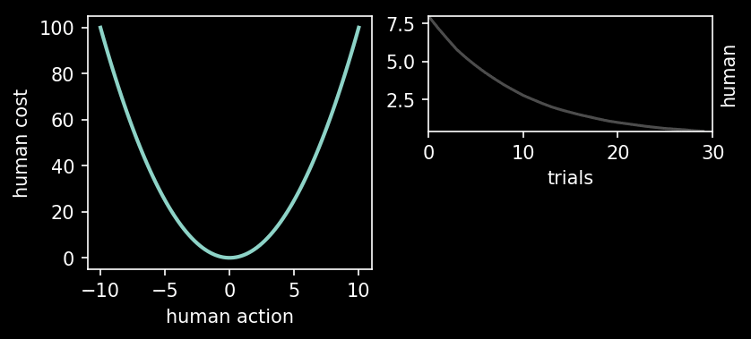
Learning to make decisions by optimization
A “rational” human minimizes its cost c_{H}(u) by descending its steepest gradient, D_{H}c_{H}(u).
Notes:
In this non-game case, the dynamics of gradient descent is simple, and as we expect, it converges to local minima.
—————————
Decision making is also a dynamic process. Especially if you don’t know much about the environment or your cost function, you may need to explore/interact with the environment to ‘learn’ about it.
If there is a minimum, we expect gradient descent like updates to converge to it.
Suppose the human’s cost function is a parabola shaped thing

Slide 18
Learning as a team: coupled optimization
A group of optimization agents minimize their own cost with respect to their own action
Notes:
In the game case, the dynamics can become much richer and counterintuitive. In this example the environment is still static, but the human and machine are learning simultaneously.

Slide 19
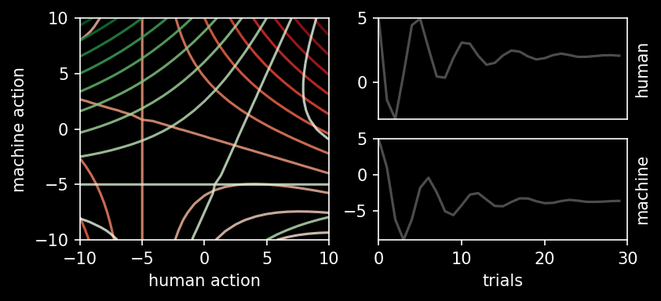
Learning as a team: coupled optimization
A group of optimization agents minimize their own cost with respect to their own action
Stable attractor:
Notes:
We can start to see what makes learning in game scenarios difficult.
Here, the agents converge to a stable attractor.

Slide 20
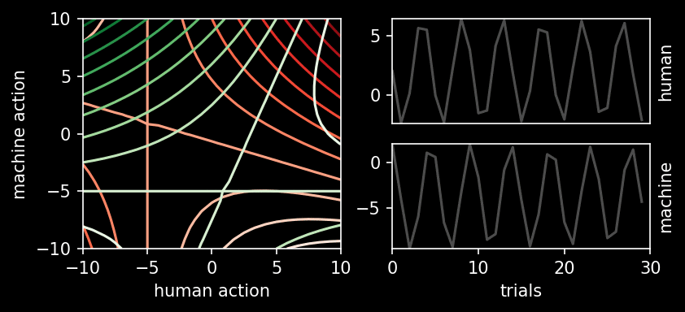
Prediction 1: periodic orbits
A group of optimization agents minimize their own cost with respect to their own action
Periodic orbit:
Notes:
But in this example, this convergence is harder to guarantee due to the coupling effects of the learning dynamics.
Using this mathematical framework we’ve developed, we can now make our first prediction.
That learning in game-theoretic settings can result in limit cycles or periodic orbits.

Slide 21
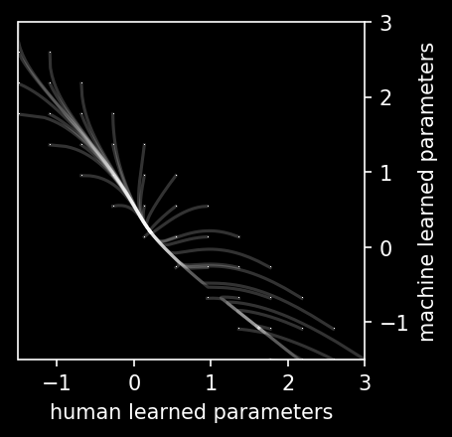
Prediction 2: Spurious attractors
Gradient learning dynamics do not guarantee convergence to (Nash) optimal solution.
Simultaneous learning:
Notes:
The second simulated example is a full scenario with a dynamic environment and non-stationary agents. It is a LQR example where agents learn using policy gradient.
With this example, we make our second prediction.
Learning in games can cause convergence to spurious attractors that

Slide 22

Prediction 2: Spurious attractors
Gradient learning dynamics do not guarantee convergence to (Nash) optimal solution.
Simultaneous learning:
Notes:
this equilibrium point is ...

Slide 23
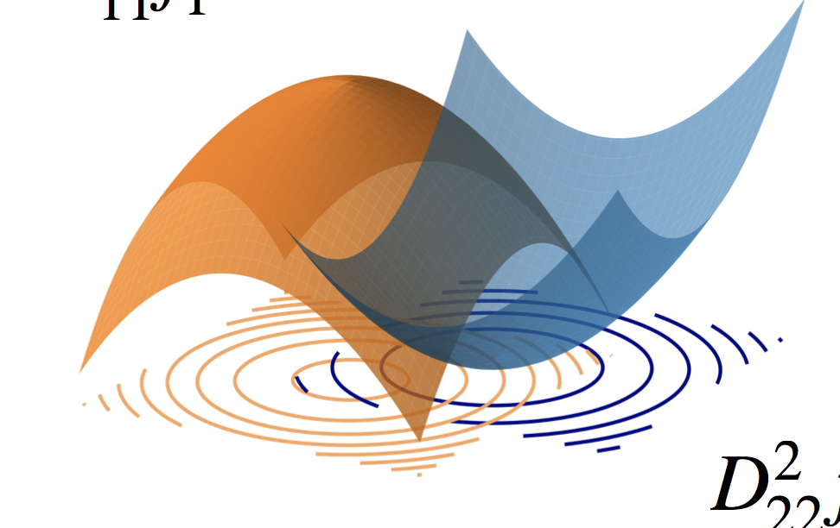
Prediction 2: Spurious attractors
Gradient learning dynamics do not guarantee convergence to (Nash) optimal solution.
Simultaneous learning:
Notes:
indeed, learning in games can be quite counterintuitiive, which is a huge motivation for why we're

Slide 24

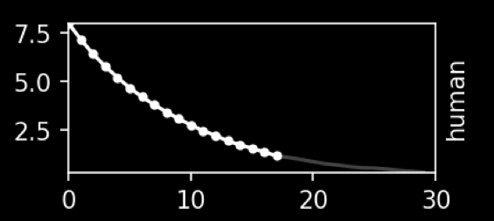
Team learning for human and machine systems
Simulation: How do the coupling effects of states and actions make learning difficult in team settings?
Experiment: How do humans effectively learn to control dynamical systems (individually + team settings)?
Notes:
Using the simulations, we now have some predictions of what ranges of things that can happen.
with the ultimate goal of studying people playing these games.
but first we want to characterize what a single agent does.

Slide 25
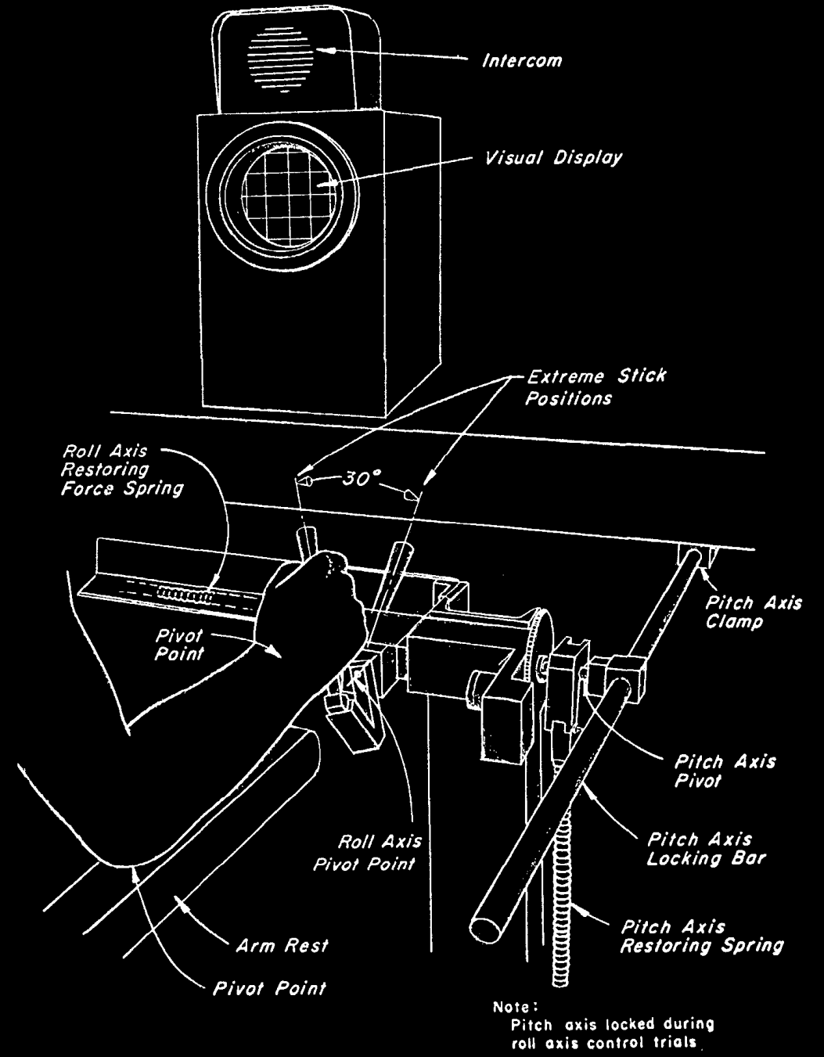
Experiment: Human teleoperation
r
reference
y
output
disturbance
d
input
u
McRuer, Krendel J Franklin Institute 1959
The Human Operator as a Servo System Element
McRuer Automatica 1980
Human Dynamics in Man-Machine Systems
Notes:
Building upon a lot of prior literature, we’ve developed a testbed where input gets fed into into a dynamical system, and we observe the resulting controller that the human uses

Slide 26
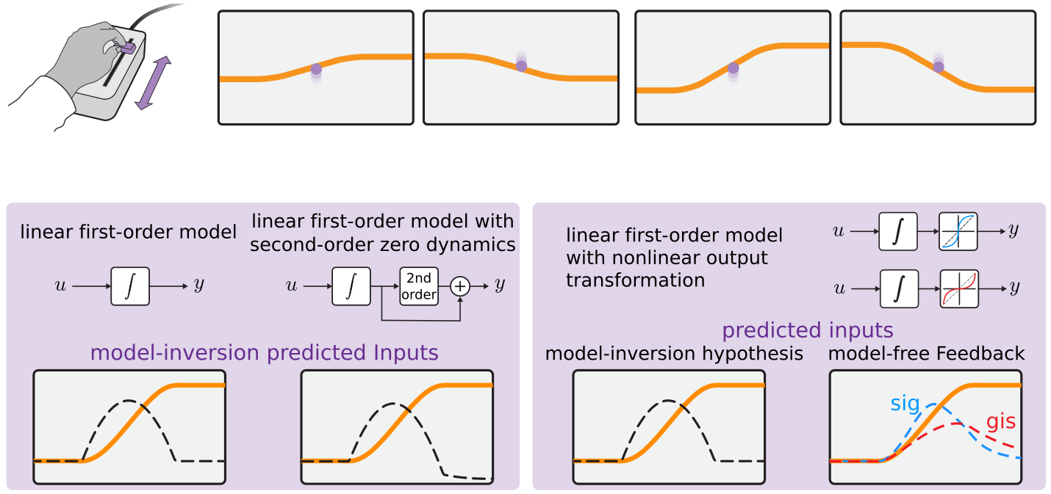




Human sensorimotor learning
subjects use 1-dimensional input device to control cursor motion to track specified reference
Roth, Howell, Beckwith, Burden SPIE 2017
Toward experimental validation of a model for human sensorimotor learning and control in teleoperation

Slide 27
human/machine system
feedforward
d
F
f
u
+
+
M
y
e
b
r
+
B
-
feedback
McRuer, Krendel J Franklin Institute 1959
The Human Operator as a Servo System Element
McRuer Automatica 1980
Human Dynamics in Man-Machine Systems
Yamagami, Howell, Roth, Burden CPHS 2018
Contributions of feedforward and feedback control in a manual trajectory-tracking task
Notes:
Previous work has gone into characterizing the feedforward model.
In this work try to understand what feedback people learn and specifically characterize the learning process.

Slide 28
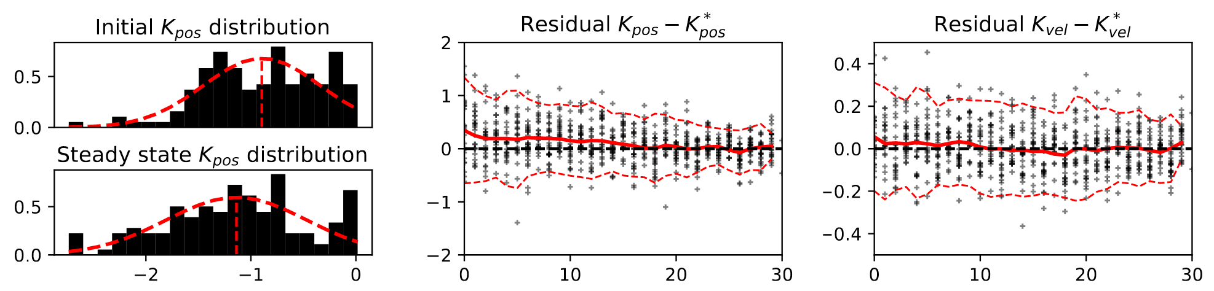
Preliminary results: sensorimotor learning
Prediction
Convergence to stationary policy
Results
Feedback gains of a second order system
Notes:
Here are some preliminary results
our prediction for the single agent case is that the humans converge to a stationary policy over a number of trials.
We get something that kind of resembles convergence, but it is still quite too noisey

Slide 29
Future work: sensorimotor games
Coupled dynamic system via haptics
Full information/limited information games
When do agents play Nash?
Notes:
1321

Slide 30



thank you!
bchasnov@uw.edu
http://students.washington.edu/bchasnov/

Slide 31
Backup slides

Slide 32
Simulation: learning to control a scalar system
First order integrator with two agents:
Simultaneous learning:
Discrete time system:
With non-cooperative costs:
Notes:
Another

Slide 33
A model of decision-making
A “rational” agent minimizes a cost c(u) subject to dynamical constraints
A cost can be decomposed into the two components: one that encodes the goal/stability, and the other effort/energy.
Dynamic environment
Notes:
The cost can be decomposed into two parts: first part encodes the cost of your goal

